Slide 1
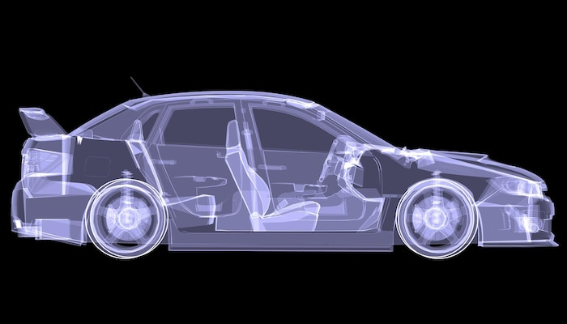

Design and Simulation of MEMS based Capacitive Accelerometers for Crash Detection and Airbag Deployment in Automobile

Slide 2
Team members
Name – Vimaleswar A Roll No – 20305 Name – Thouti Ruthik Goud Roll No - 20288

Slide 3
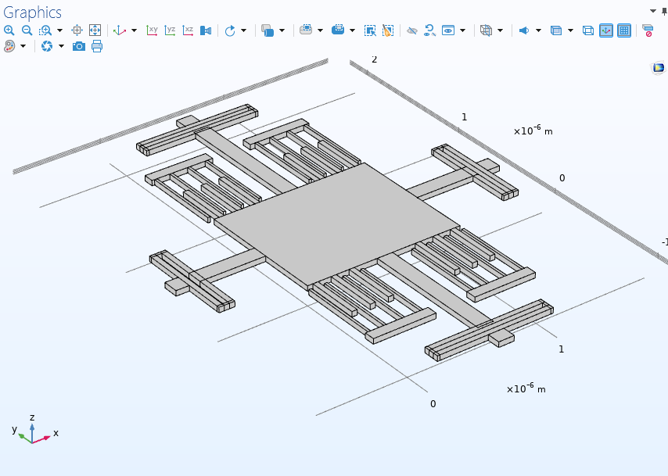
What we did?
The objective of our project is to design a 2-axis MEMS accelerometer and analyze the displacement and stress of the body when external accelerations applied along the x-axis and y-axis. Certain alterations with respect to the design of the accelerometer are done to study the difference in performance. We also tried the displacement and stress analysis for the same design with some adjustments in the thickness i.e., increase the thickness from 40 to 160 nm to perform analysis to measure acceleration along z-axis direction which is the novely of our project.

Slide 4
Why we did this?
Capacitive accelerometers have several advantages over other types of accelerometers in certain applications. Here are some of the advantages:
1.High Sensitivity and Resolution: Capacitive accelerometers can achieve high sensitivity and resolution, making them suitable for applications that require precise measurement of small accelerations. This high sensitivity allows them to detect subtle changes in motion.
2.Low Power Consumption: Compared to some other accelerometer technologies, capacitive accelerometers often have lower power consumption. This can be advantageous in battery-operated devices or applications where power efficiency is crucial.
3.Miniaturization: Capacitive accelerometers can be designed in small form factors, making them suitable for applications where space is limited or where miniaturization is a critical requirement. This is particularly important in industries such as consumer electronics and medical devices
4.Long-Term Stability: Capacitive accelerometers can offer good long-term stability in terms of their performance. They are less prone to drift over time, ensuring reliable and consistent measurements over extended periods.
5. Reduced Thermal Sensitivity: Capacitive accelerometers may exhibit lower sensitivity to temperature variations compared to some other accelerometer types. This characteristic is beneficial in applications where temperature changes might impact the accuracy of acceleration measurements.

Slide 5
How we did?
We implemented the model in comsol multiphysis 6.0 software. First, to get familiarity with the comsol software we implemented a basic model (Toy model) with one finger attached to the proof mass on each side which results in four capacitors in total. We stimulated this toy model to measure the x-axis displacement.
Next, We Implemented the accelerometer design as mentioned in the research paper. This design is complex when compared to our toy model as it has twelve fingers, four supporting beam and another supporting structures. In Comsol we built approximately 58 blocks separately and connected them with union operation, after that we applied boundary conditions like fixed constraints and also we used polysilicon as the material for design as instructed in the paper.
Next, we applied volumetric acceleration on the body along X-axis, Y-axis, Z-axis separately and measured their displacement respectively and done stress analysis for each axis separately.

Slide 6
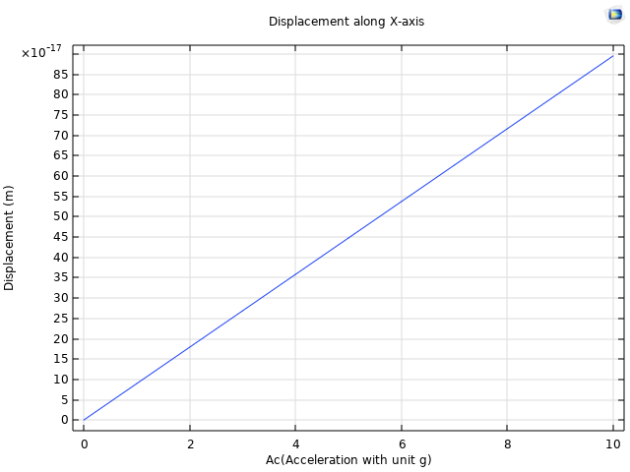
Displacement along x-axis

Slide 7
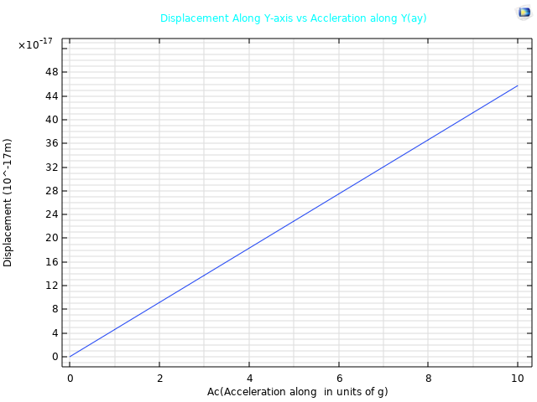
Displacement along y-axis

Slide 8
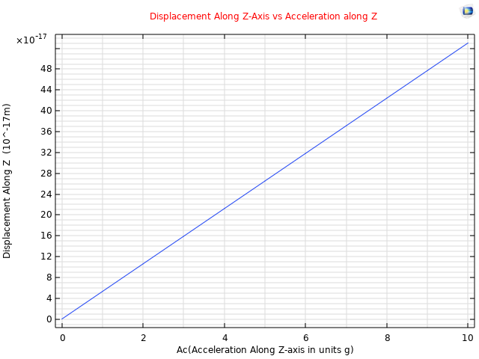
Displacement along z-axis

Slide 9
Stress analysis when acceleration along z-axis

Slide 10

Thank You

